Slide 1

DEEP DOUBLE DESCENT:
WHERE BIGGER MODELS AND MORE DATA HURT
Nakkiran et al. (2019)
Group 7

Slide 2
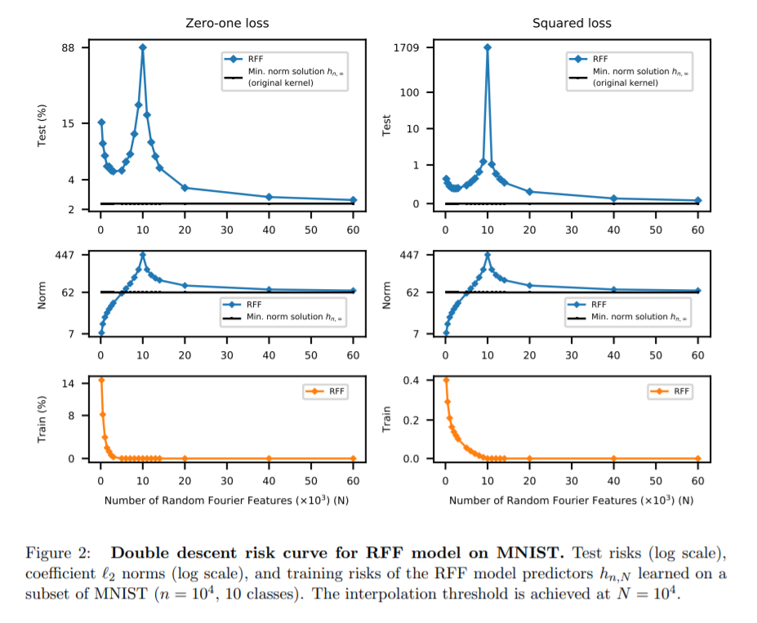
Double Descent: An Overview
Breaks with classical theory: bias-variance tradeoff
Belkin et al. (2018) demonstrate double descent of test loss beyond interpolation threshold: n = p
Model underspecified; zero train error
minimise Euclidean norm
Allows reduction of inductive bias
Caveats: SGD sensitive to initialisation in underparametrised setting; computational constraints (e.g. ImageNet)
Demonstrated in tools often deployed with high p e.g. 2-layer neural networks, but also others e.g. decision trees using MNIST and CIFAR-10
From Belkin et al. (2018) Reconciling modern machine learning practice and the bias-variance trade-off PNAS https://doi.org/10.1073/pnas.1903070116
Notes:
Figure describes 2-layer neural network (equivalent to Random Fourier Features; RFF) run on MNIST
ImageNet [33], which has ∼106 examples and ∼103 classes, may require networks with ∼109 parameters to achieve interpolation
Right of the interpolation threshold, all function classes are rich enough to achieve zero training risk -> Select parameters using L2 norm
No guarantee the most regular, smallest norm predictor consistent with training data is contained in the class for any finite N (sample size)
Increasing N allows us to construct progressively better approximations to that smallest norm function -> expect to have learned predictors with largest norm at the interpolation threshold and for the norm to decrease monotonically as N increases thus explaining the second descent segment of the curve (SEE FIGURE 2 SHOWN ON SLIDE)
hn,∞ has better accuracy than all hn,N for any finite N -> circumvent inductive bias
The CIFAR-10 dataset consists of 60000 32x32 colour images in 10 classes, with 6000 images per class. There are 50000 training images and 10000 test images.

Slide 3
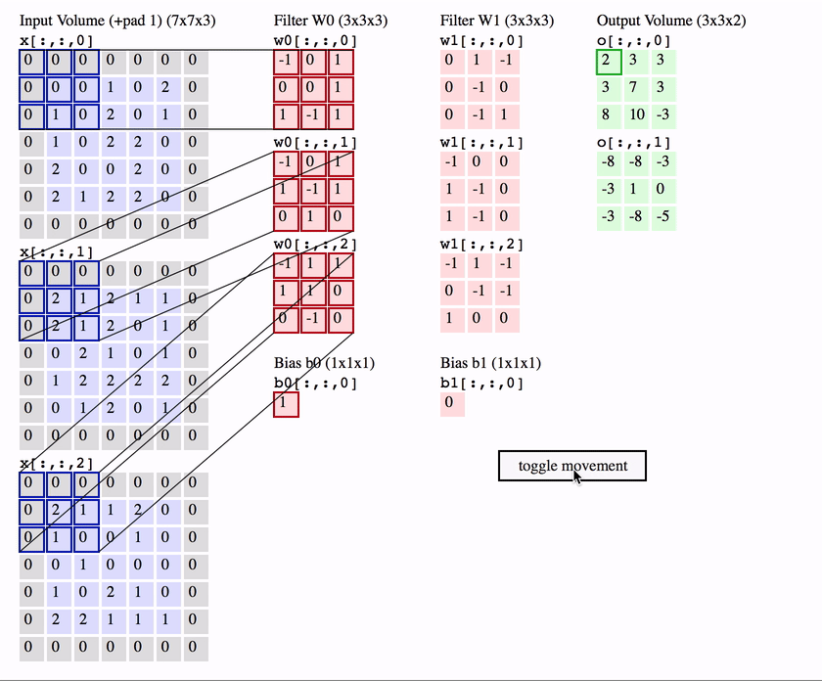
Convolutional Neural Networks (CNN)
Features depend on small neighborhoods of pixels -> Retain locality
Same features can been located everywhere on the image - Shift / Translation-Invariance
Hyper-parameters
Width and Height
Number of input and output channels
Example Applications
Image and video classification recognition
recommender systems
natural language processing

Slide 4
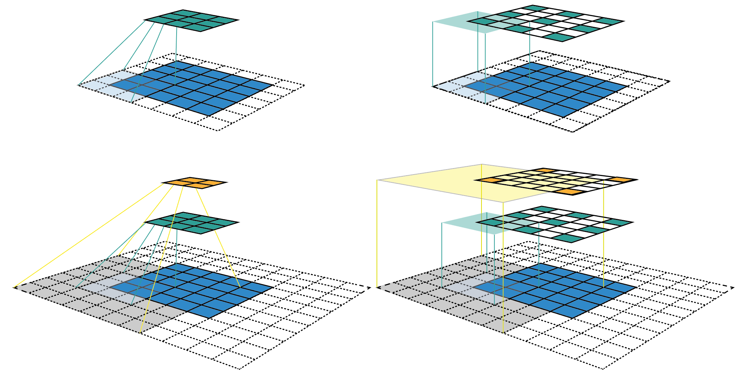
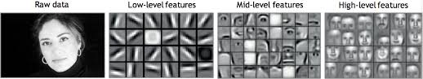
Features Map and Width Parameter k
The feature maps (also activation maps) capture the result of applying specific filters that scanning the expanse of the input image to a layer, the feature map is the output of that layer. The reason for visualising a feature map for a specific input image is to try to gain some understanding of what features our CNN detects and discern specific characteristics or attributes.

Slide 5
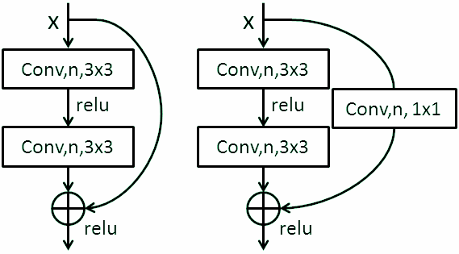
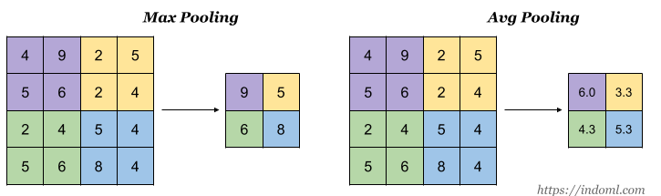
Batch Normalization
Normalize the input by re-scaling and re-centering
Fix means and variances at each layer’s inputs
Improving speed, performance and stability of ANN
Pooling Layers
Reduces the dimensionality of the data
Max or Average Pooling
Improving speed, performance and stability of ANN
Residual-Connections:
F(x) + x
Skip connections, or shortcuts to jump over some layers
Deals with the Vanishing Gradient Problem

Slide 6
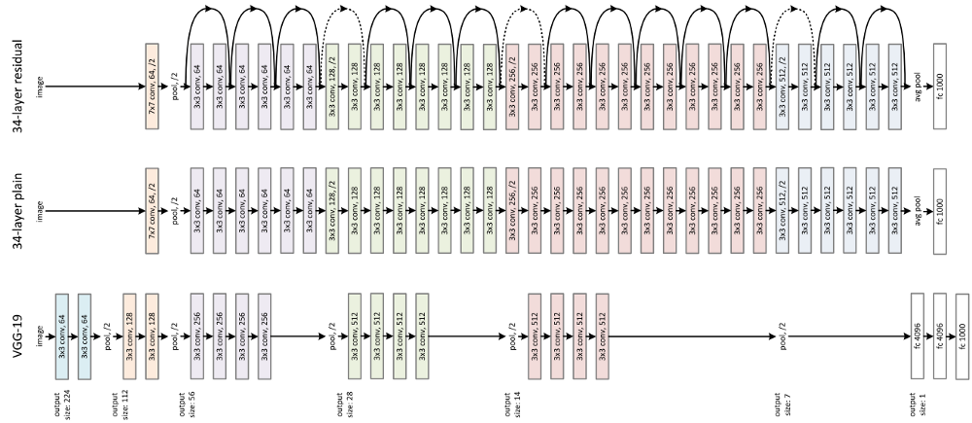
Various Architectures: AlexNet/ResNet/VGG/GoogleNet
Serial or Parallel Deployment
Of BLOCKS (Residual or not) composed of:
Convolutive Filters
Max/Average Pooling Layers
Batch Normalization Layers
Dropout Layers (Used to avoid model overfitting)
Activation Functions:
(Linear,Sigmoid,Tanh,RELU,Softmax,ELU,Leaky RELU,...)
Flattening and feed to common Fully Connected neuron layers
etc...
(can be arranged in multiple combinations /
depends the task)

Slide 7

Transformers
Attention Based Model Architectures
Positional Encoding of the embeddings
Maintain Time-Dependency (like RNN)
Able to parallelize (per layer)
Currently state of the art for various NLP applications and Neural Machines Translators.

Slide 8

Nakkiran et al. (2019) Deep Double Descent: Key Contributions
Generalise double descent phenomenon via effective model complexity: maximum number of samples on which procedure can reach approx. 0 training error
Depends on training time, as well as data distribution and classifier architecture
Demonstrate model-wise double descent for DL
Epoch-wise double descent; except for critically parametrised models
Non-monotonicity of loss by sample size: More data is worse!
Investigate effects of label noise (proxy for model misspecification)
...conventional wisdom in classical statistics is that, once we pass a certain threshold, “larger models are worse.” However modern neural networks exhibit no such phenomenon. Such networks have millions of parameters...and yet they perform much better on many tasks than smaller models.

Slide 9
Effective Model Complexity
The EMC of a training procedure is defined to be the maximum number of samples on which the training procedures achieve a training error equivalent to 0.
Under-Parameterized
Over-parameterized
Critically-parameterized

Slide 10
The label noise
LB comes from several sources :
Encoding problems
Insufficient information
LB can have several effects :
Decreasing or increasing the complexity of learned models
Accentuate the Double Descent phenomenon

Slide 11
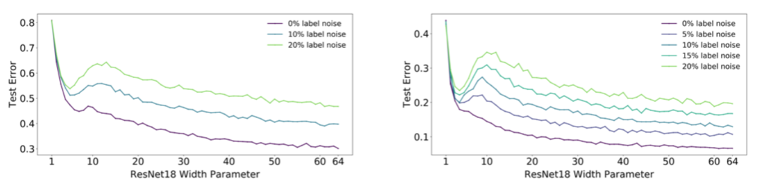
Model-wise : The test error of models of increasing size
Aim : Varying the number of parameters to increase the model size of the model capacity
How? By varying the width of the network
It means? Increasing the number of filters of the convolutional layers

Slide 12
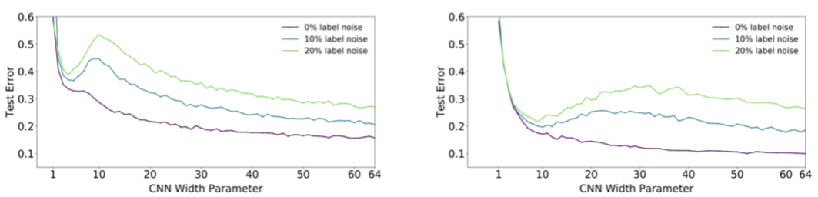
Model-wise : CNN
Without data augmentation
With data augmentation
Data augmentation : Process of increasing the amount of training data by creating new data from existing ones

Slide 13
Epoch-wise
One Epoch is when an entire dataset is passed forward and backward through the neural network only once.

Slide 14
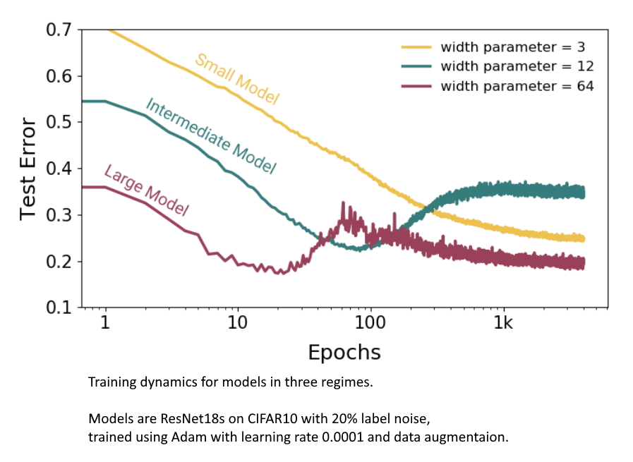
Epoch-wise
Sufficiently large model can undergo a “double descent” behaviour
Intermediate Models follow the U curve

Slide 15
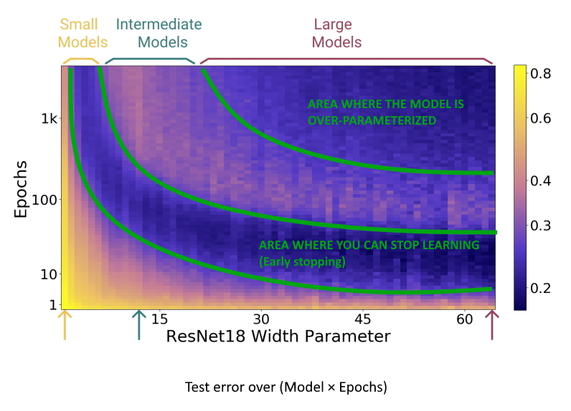
Epoch-wise
Early stopping is a form of regularization used to avoid overfitting

Slide 16
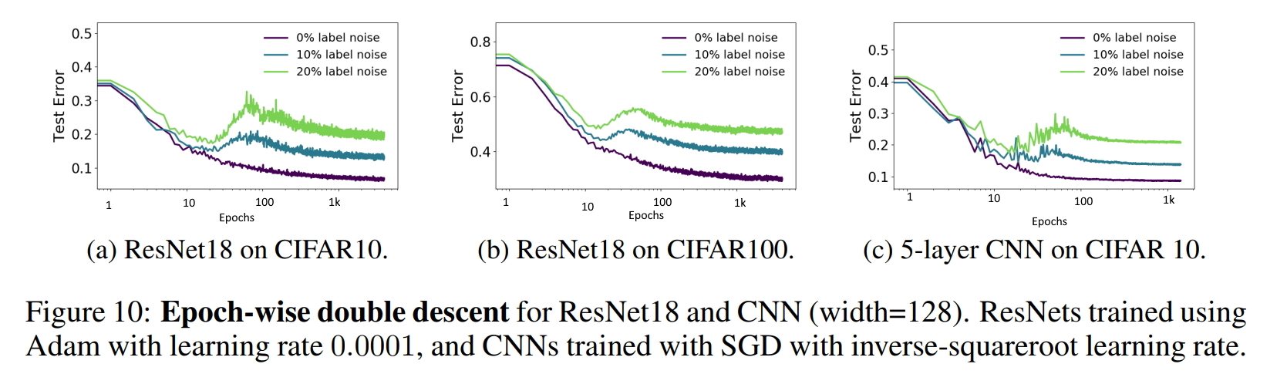
Epoch-wise
Convention wisdom will say it is the bias/variance tradeoff.
First the neural network generalizes, then it over-fit the training data.
The paper suggests that this knowledge is not always true.

Slide 17
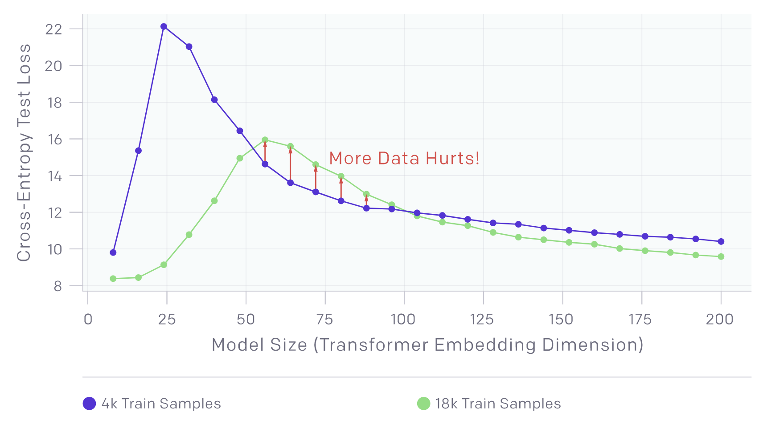
Sample-wise Non-monotonicity
Test Error VS Training Sample Size

Slide 18
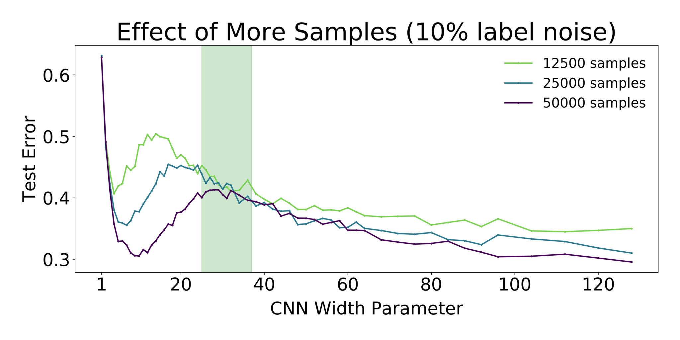
Sample-wise Non-monotonicity
Adding data points doesn’t continually decrease our test error.
Around the critical interval where EMC ≈ n, an increase in the sample size may result to an increase of the test error
An increase of data points causes some kind of “shift” of the curve to the right

Slide 19
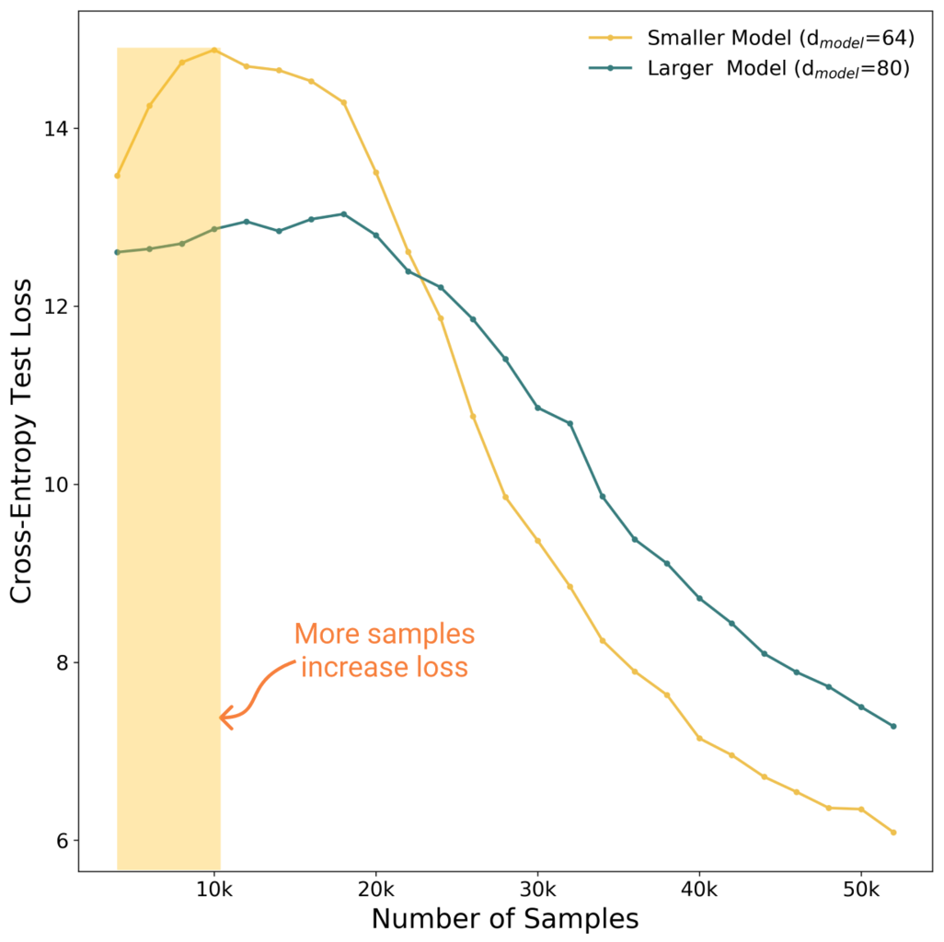
Sample-wise Non-monotonicity
Here, when we combine the effects that model size and sample size have on the model, we can see that :
MORE DATA HURTS TEST PERFORMANCE

Slide 20
Criticisms and Perspective
Computationally infeasible for many datasets or model types
Sensitivity of some optimisation techniques
Lack of specification of ε in the effective model complexity metric in a principled way
Authors do not specify what constitutes a sufficiently distant effective model complexity from the sample size, n

